Slide 1
Section 4.3 Trigonometric ratios
© Copyright all rights reserved to Homework depot: www.BCMath.ca

Slide 2
How to Rationalize:
Rule: Do not leave a radical in your denominator
Multiply the top and bottom by the same radical in the denominator
This will eliminate radical in your denominator

Slide 3
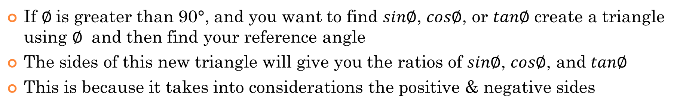
REVIEW: What Are Reference Angles for?
If $∅$is greater than 90°, and you want to find $sin∅$, $cos∅$, or $tan∅$ create a triangle using $∅$ and then find your reference angle
The sides of this new triangle will give you the ratios of $sin∅$, $cos∅$, and $tan∅$
This is because it takes into considerations the positive & negative sides
Ie: Suppose we want to find $sin\frac{5π}{4}$, $cos\frac{5π}{4}$, and $tan\frac{5π}{4}$
First Draw this angle in Q3
Draw the triangle in Q3 with the X-axis
Find the reference angle, the central angle with the X-axis
Suppose we know the lengths of all the sides in this triangle
TO find $sin\frac{5π}{4}$, we would use the sides of this triangle

Slide 4
Practice: Find the reference angles for the following Angles

Slide 5
i) Review: Special Triangles
There are two types of special triangles:
30°, 60°, 90° triangle (Equilateral Triangle) and
45°, 45°, 90° triangle (Isosceles-Right Triangle)
Equilateral Triangle
Isosceles-Right Triangle
All sides and angles are equal
Two sides are equal and one angle Is equal to 90°
Cut it in half
Use Pythagorean Thm. to find the hypotenuse of the triangle
Use Pythagorean Thm. to find the height of the triangle
Isoceles → 2 equal angles
© Copyright all rights reserved to Homework depot: www.BCMath.ca

Slide 6
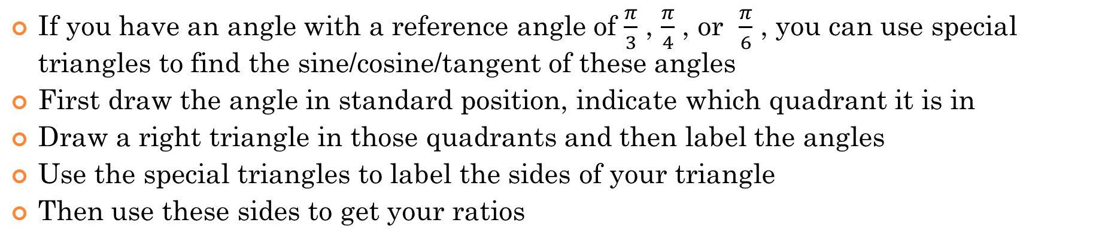
Using Special Triangles to find Sine/Cosine/Tangent of angles
If you have an angle with a reference angle of $\frac{π}{3}$ , $\frac{π}{4}$ , or $\frac{π}{6}$ , you can use special triangles to find the sine/cosine/tangent of these angles
First draw the angle in standard position, indicate which quadrant it is in
Draw a right triangle in those quadrants and then label the angles
Use the special triangles to label the sides of your triangle
Then use these sides to get your ratios
Ex: Fine the exact value of sine/cosine/tangent of 330° [$\frac{11π}{6}$ ]
Q: Which quadrant is 330° in?
Q: What is the reference angle?
Make the triangle using the ref angle
Q: Is this a special triangle?

Slide 7
Draw the angle in standard position
Find the reference angle
Draw the 30°, 60°, 90° triangle
NOTE: Rationalize your Answers from now on!!!!

Slide 9
I) Reciprocal of Trigonometric Functions
Cosecant (csc) is the reciprocal of the sine function
Secant (sec) is the reciprocal of the cosine function
Cotangent (cot) is the reciprocal of the tangent function
© Copyright all rights reserved to Homework depot: www.BCMath.ca

Slide 10
Ex: Determine the value of each expression to 3 decimal places

Slide 11
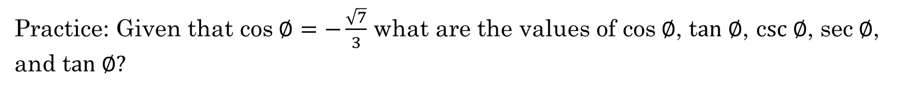
Practice: Given that cos$∅=−\frac{\sqrt{7}}{3}$ what are the values of cos$∅$, t$an ∅$, c$sc ∅$, sec$∅$, and t$an ∅?$
When given one of the trig. Ratios and asked to find the other 5 trig ratios, use the Pythagorean Thm

Slide 12
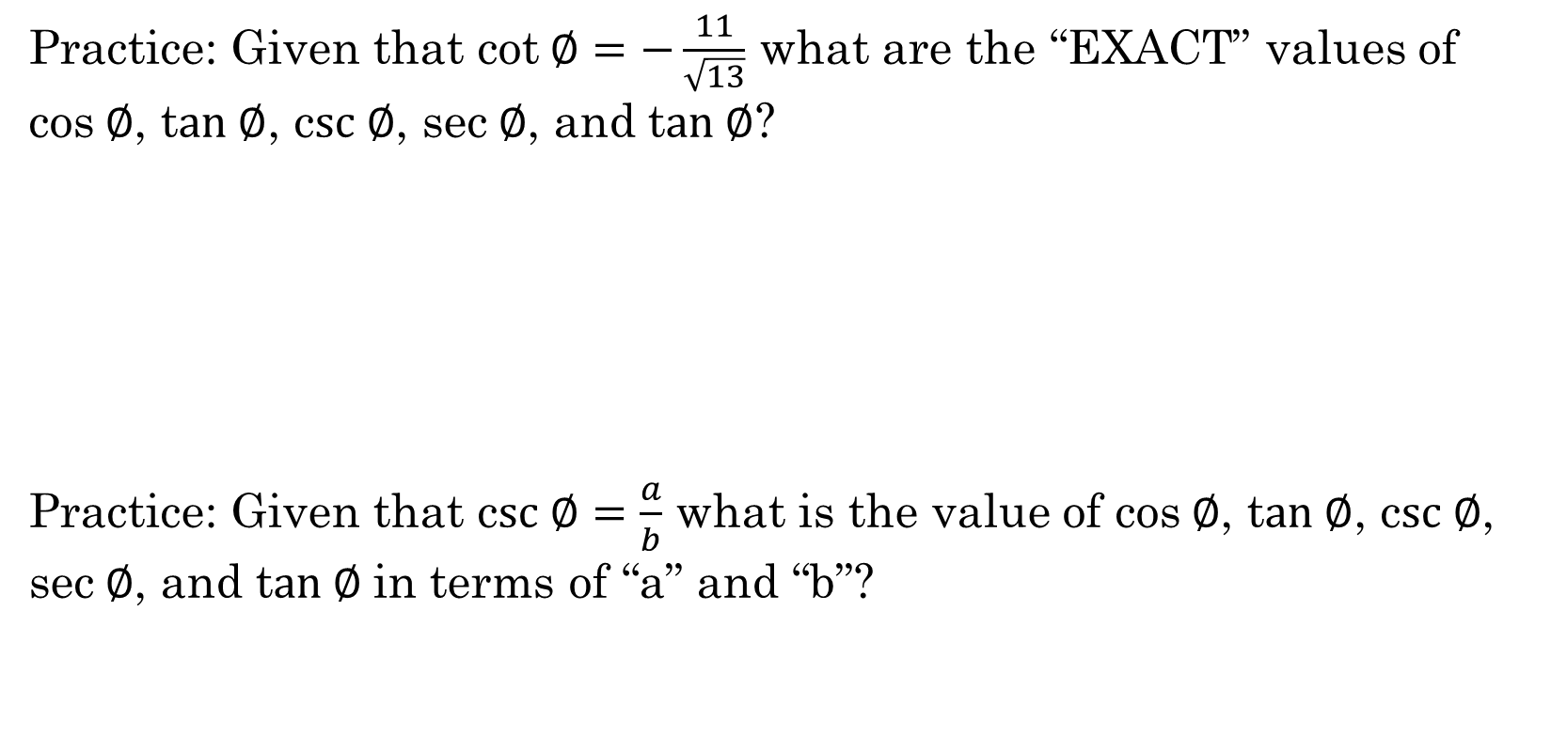
Practice: Given that cot$∅=−\frac{11}{\sqrt{13}}$ what are the “EXACT” values of cos$∅$, t$an ∅$, c$sc ∅$, sec$∅$, and t$an ∅$?
Practice: Given that c$sc ∅=\frac{a}{b}$ what is the value of cos$∅$, t$an ∅$, c$sc ∅$, sec$∅$, and t$an ∅$in terms of “a” and “b”?

Slide 13
Ex: Given point P(3,4) in the diagram, how many of the trig. values are correct?

Slide 14
Ex: Given that point “P” (7,-3) is on the terminal arm with angle $∅$, find the ratios of all six trig functions:

Slide 15
Ex: Given that 0< θ< 2π , tanθ > 0 and sinθ < 0, what quadrant is the angle in?
If tanθ > 0 (positive), then it can only be in quadrants 1 and 3
If sinθ < 0 (negative), then it can only be in quadrants 2 and 3
To satisfy both conditions, then the angle must be in quadrant 3
© Copyright all rights reserved to Homework depot: www.BCMath.ca

